Slide 1
Streaming Platform Analysis
Group 6
CHEN, Taoyue 1155141543
LAU, Ho Cheung 1155157540
LI, Yuji 1155157174
POON, Yin Ki
ZHAO, Shengchun 1155157253

Slide 2
Problem Statement
How to choose a streaming platform?
Should audiences pay for newly released movie ？
Notes:
Nowadays, with the fast development of online movie streaming platforms, people can access more abundant resources for movies than ever without having to travel to the movie theatre. However, there are many streaming platforms available for selection, and often subscriptions for membership are required for consumers to access the content. Also, some new movies produced by the streaming platform can only be viewed on their website and must be bought separately. Which streaming platforms should you choose so that you can access more contents that you are interested in? Should you pay for that newly released movie that has few reviews? To help consumers make more informed choices before they purchase a membership or a new movie, we did a series of analyses with two datasets on four streaming platforms, Prime Video, Netflix, Hulu and Disney+.

Slide 3
Introduction
of the
Dataset
Notes:
Before diving into our analysis, we want to briefly introduce our two datasets.

Slide 4
Two sets of dataset
Part 1 & 3
Part 2
16 thousand movie records and their features
movie records and their release date on the corresponding platform
Notes:
The first set of data contains around 16 thousand movie records and their features like runtime, genre and language, together with their IMDb rating. We used the first set of data in Part 1 and Part 3. It is the dataset used in the case study.
The second set of data is from the Kaggle website. The dataset contains movie records and their release date on the corresponding platform. However, there is little data about the movies on prime video. So, we only analyse and make predictions for Netflix, HULU and Disney+ in part 2.

Slide 5
Approach to the Problem
Part 1 | Expository data analysis of our movie data to navigate platform-based characteristics of movies
Part 2 | Forecasting the number of new movies available on each platform(Hulu, Disney, Netflix)
Part 3 | Modelling the relationship between features of a movie and its IMDb rating
Notes:
Our analysis is structured in three parts:
Exploratory data analysis of our movie data to navigate platform-based characteristics of movies
Forecasting the number of new movies available on each platform(Hulu, Disney, Netflix)
Modelling the relationship between features of a movie and its IMDb rating

Slide 6
01
Expository Data Analysis result

Slide 7
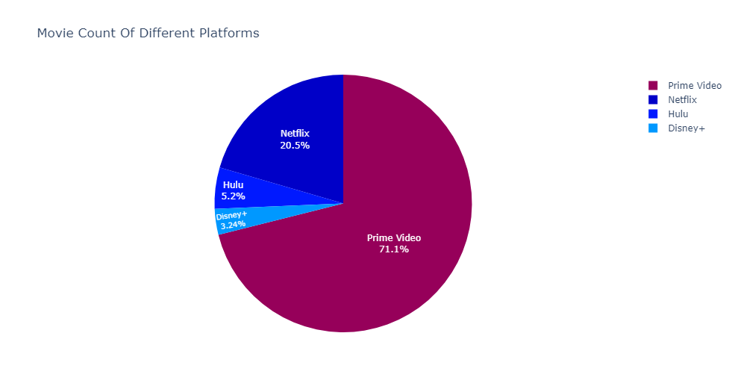
Analysis result in case 25
01
Platforms by the number of movies they have

Slide 8
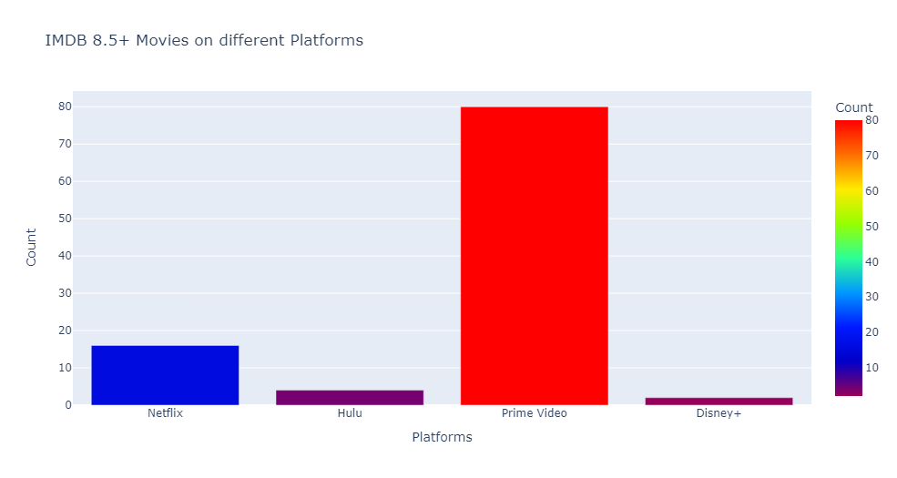
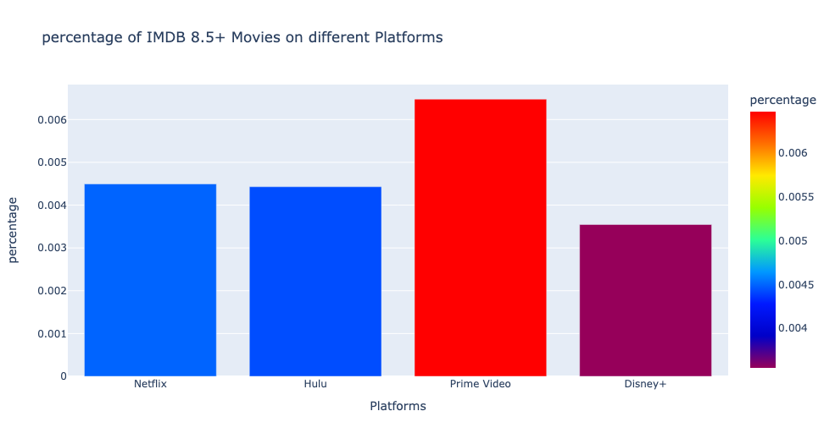
Analysis result in case 25
02
Platforms by the number and percentage of high-quality(IMDb 8.5+) movie
By quantity:
By percentage:

Slide 9
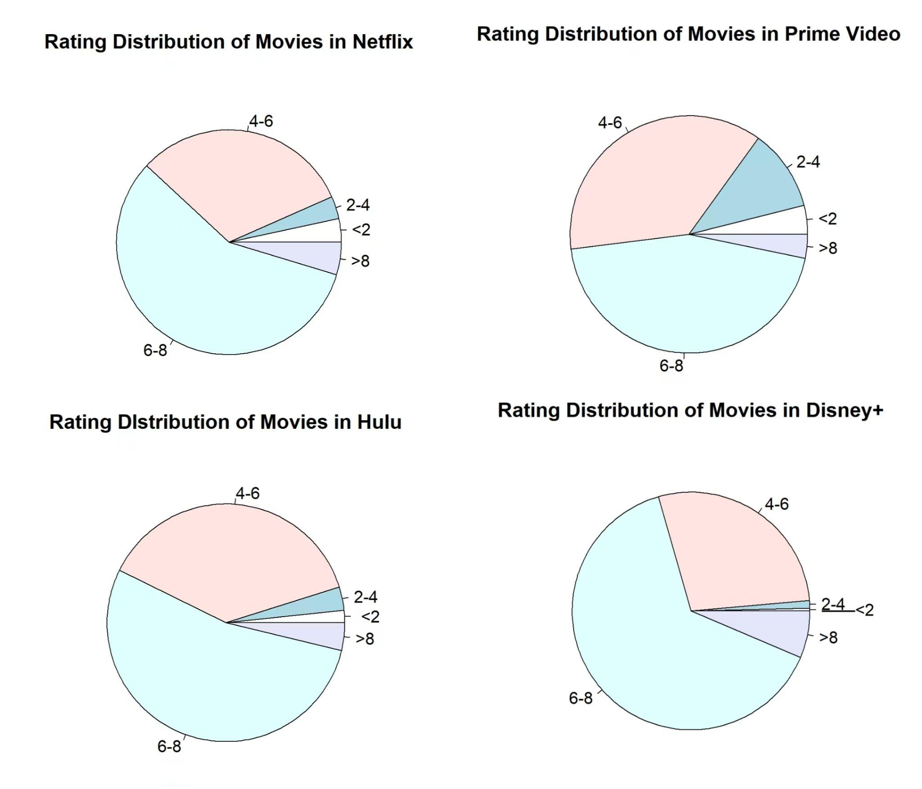
02
Platforms by the number and percentage of high-quality(IMDb 8.5+) movie

Slide 10
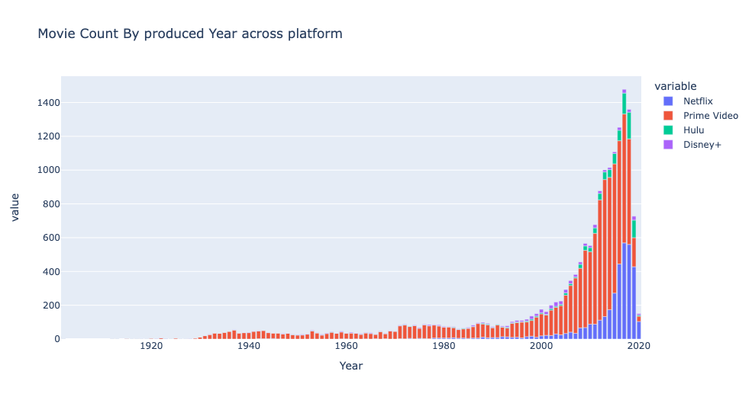
Extended Analysis of case 25
03
Platforms by the number of movies available with different production years from 1915 to 2020.

Slide 11
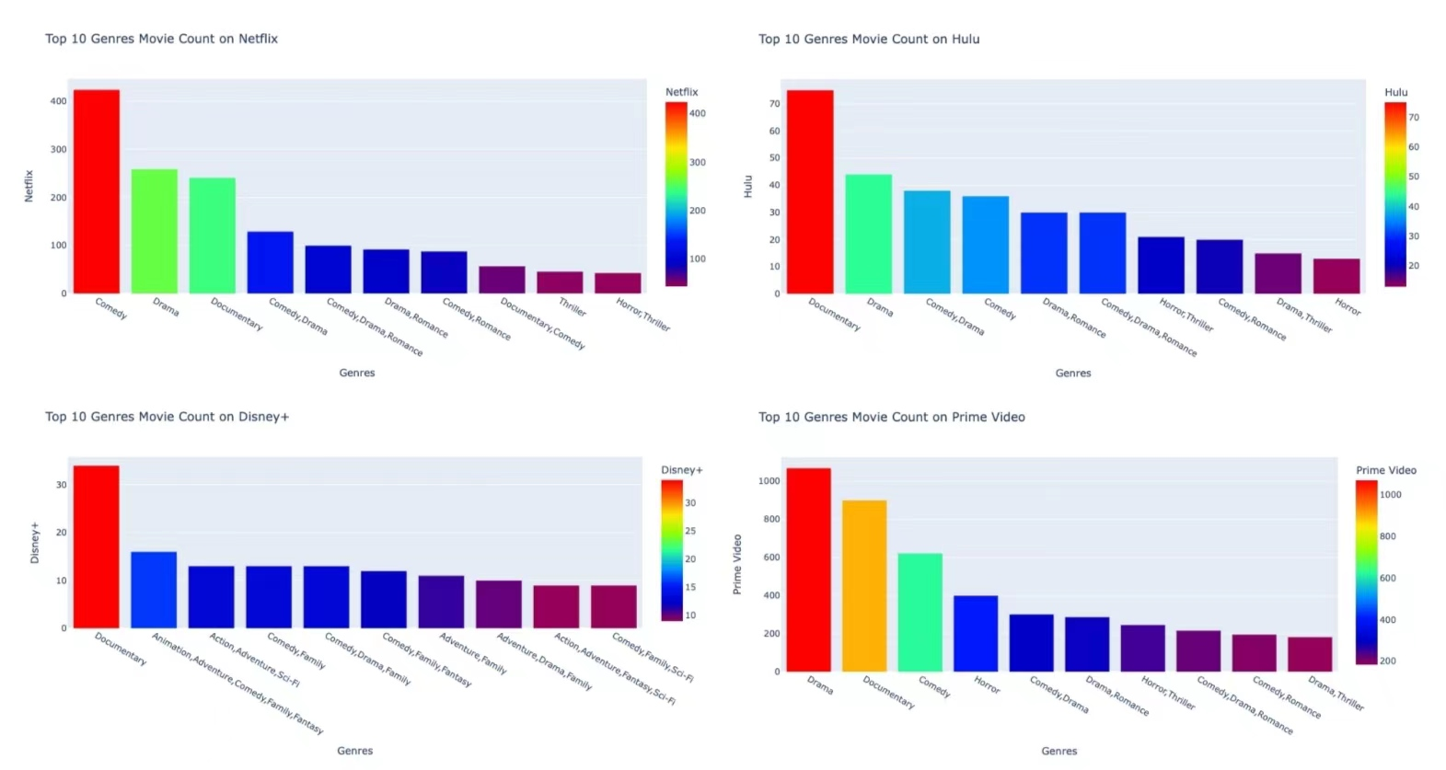
04
Extended Analysis of case 25
Platforms by their top ten genres of movies

Slide 12
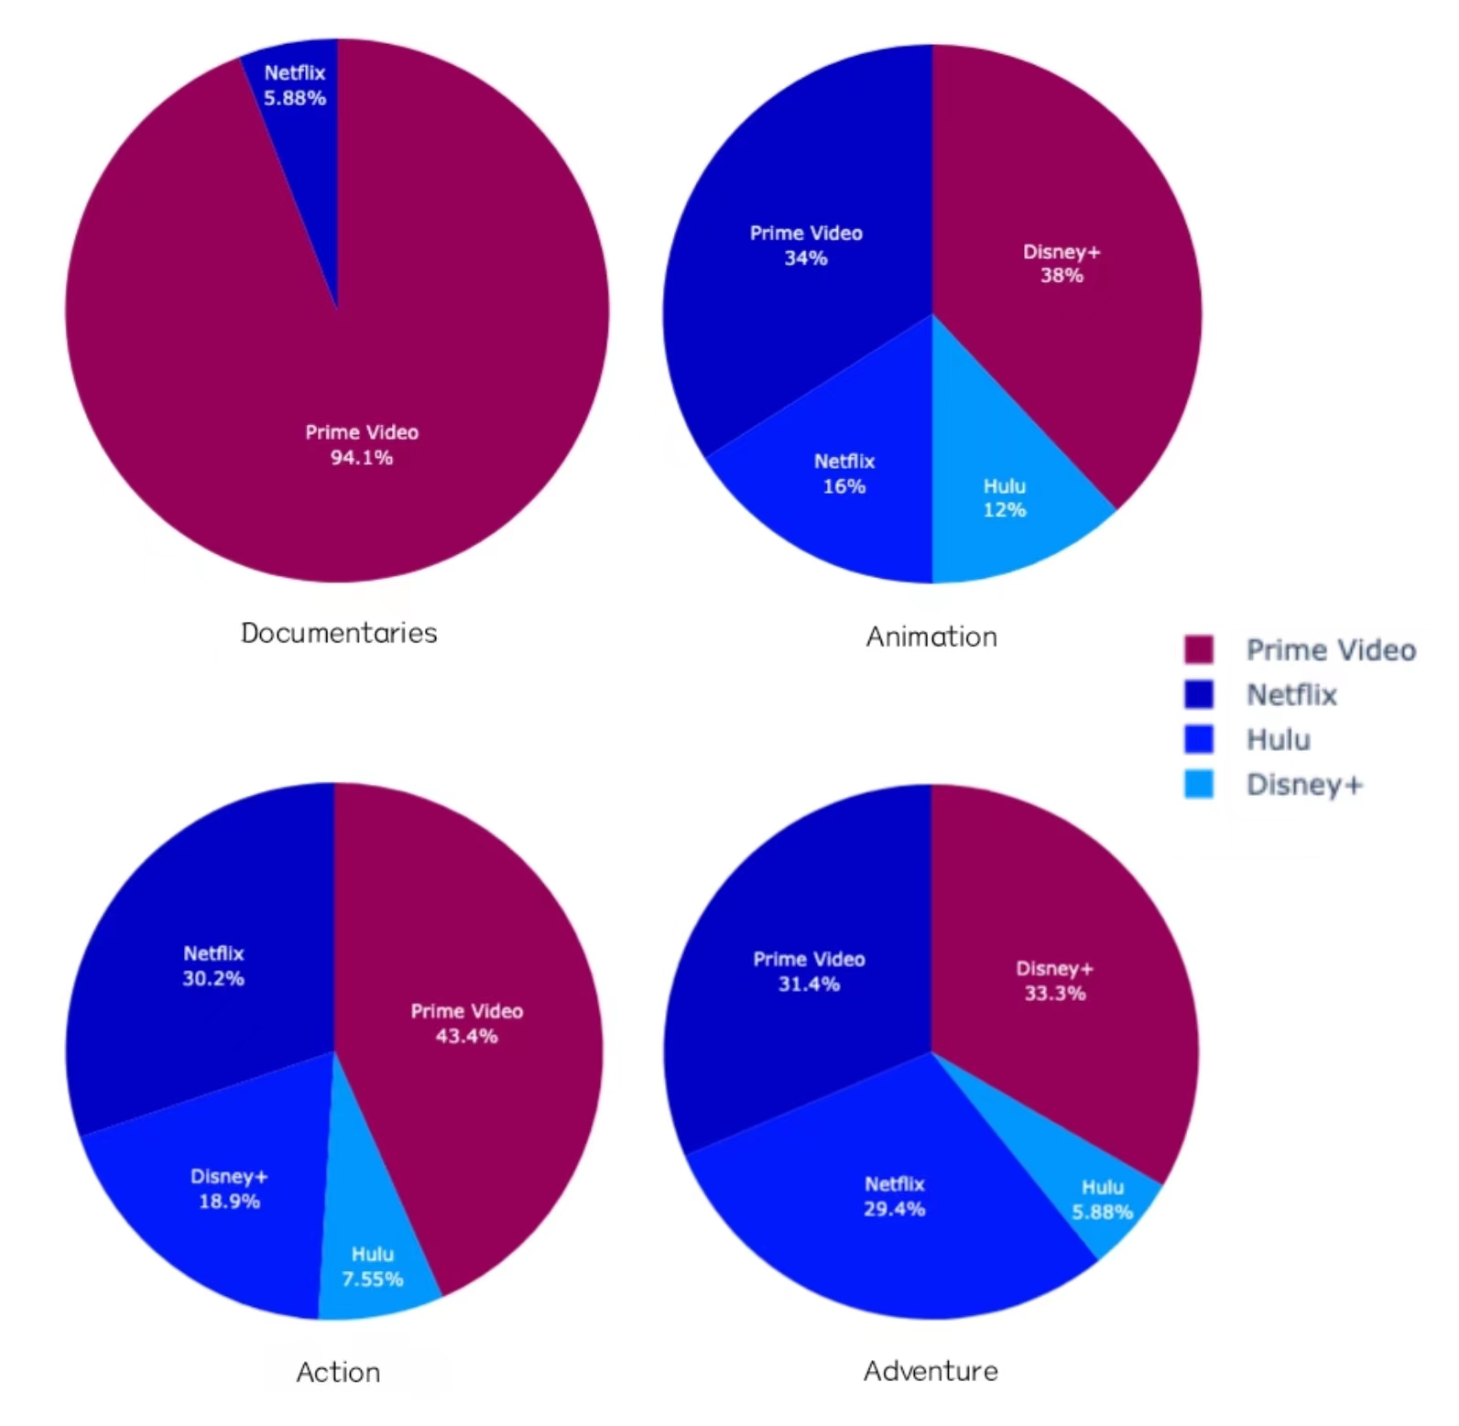
Extended Analysis of case 25
05
Platforms shares of top 50 movies in Genre Documentaries, Action, Animation, and Adventure

Slide 13
90%
95%
94%
71%
Extended Analysis of case 25
Netflix
Prime Video
Disney+
Hulu

Slide 14
Limitation ?
Completeness
or
representability
of our dataset

Slide 15
02
Forecasting the number of new movies in 2023
Which platforms will have more new contents?

Slide 16
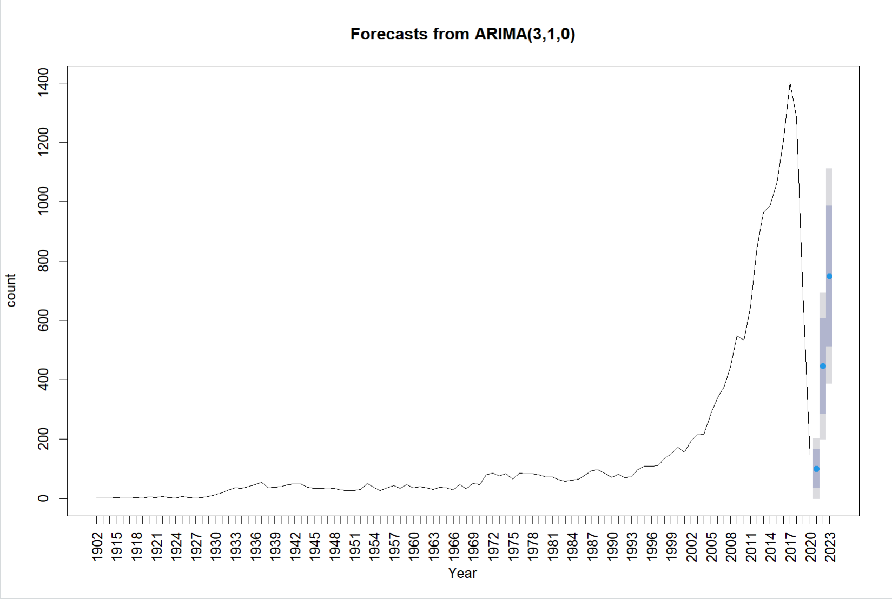
Overall Movie Market Forecasting
Rapidly developed around 2002
Reached the peak around 2017

Slide 17
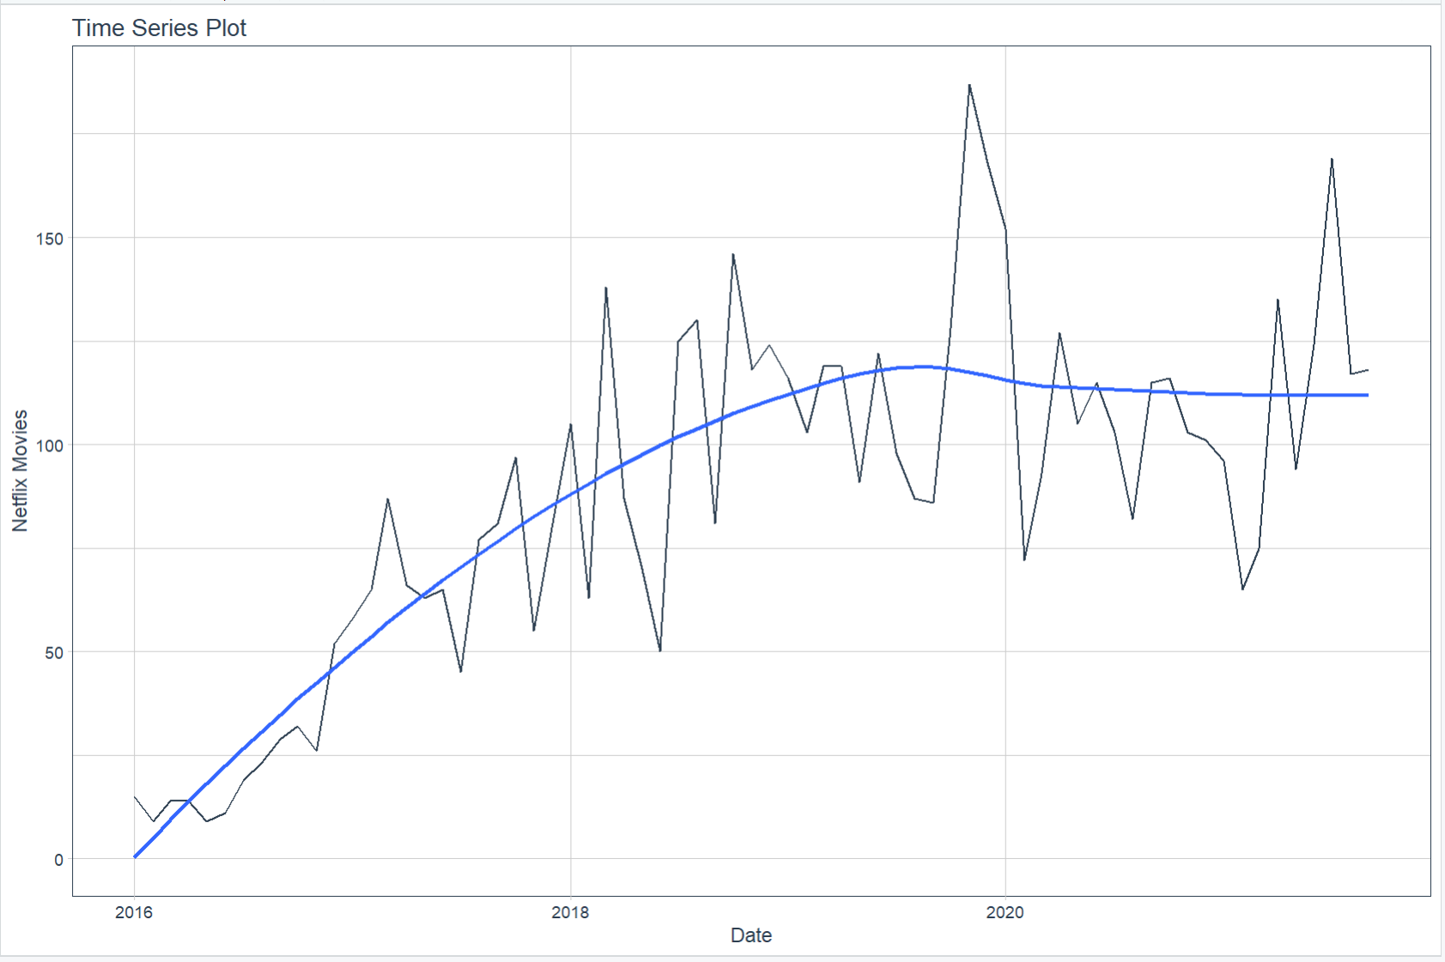
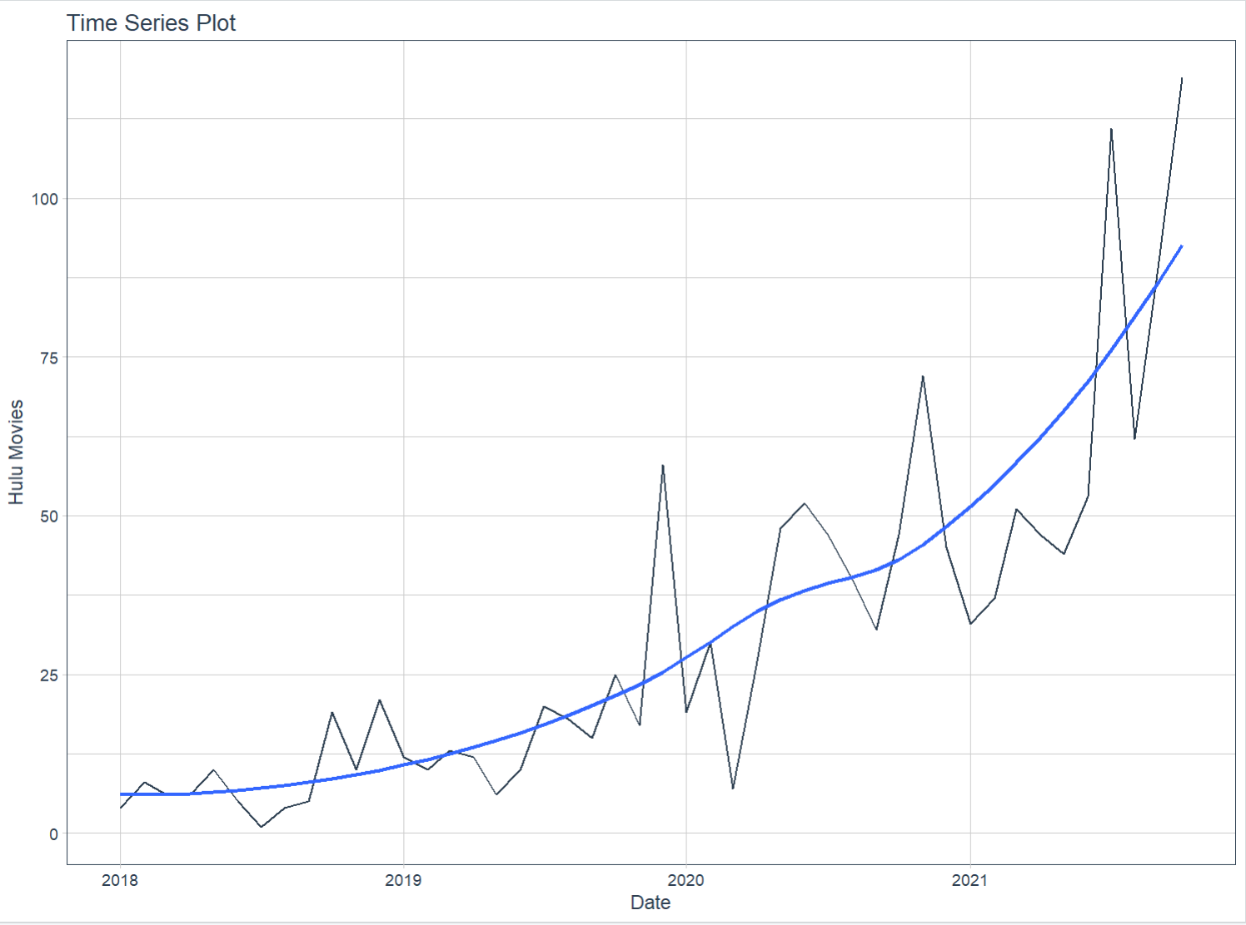
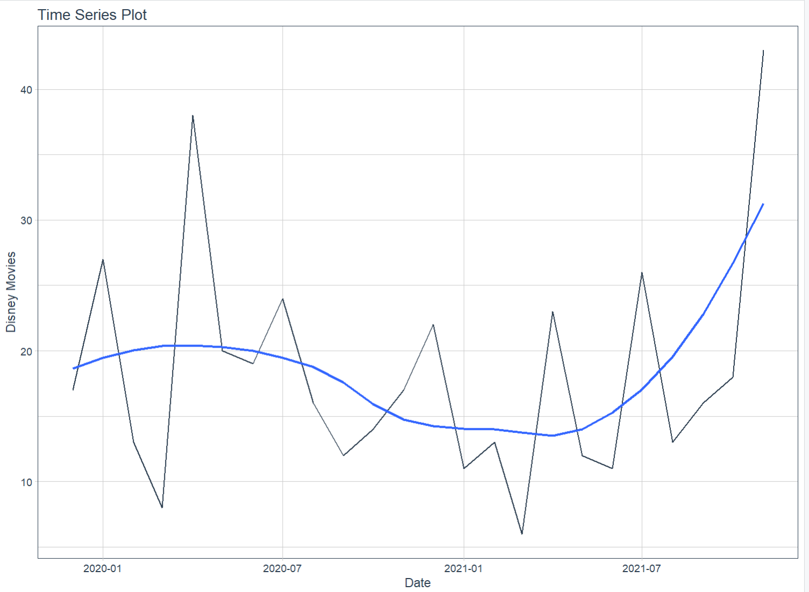
Data Visualization
Netflix
Hulu
Disney

Slide 18
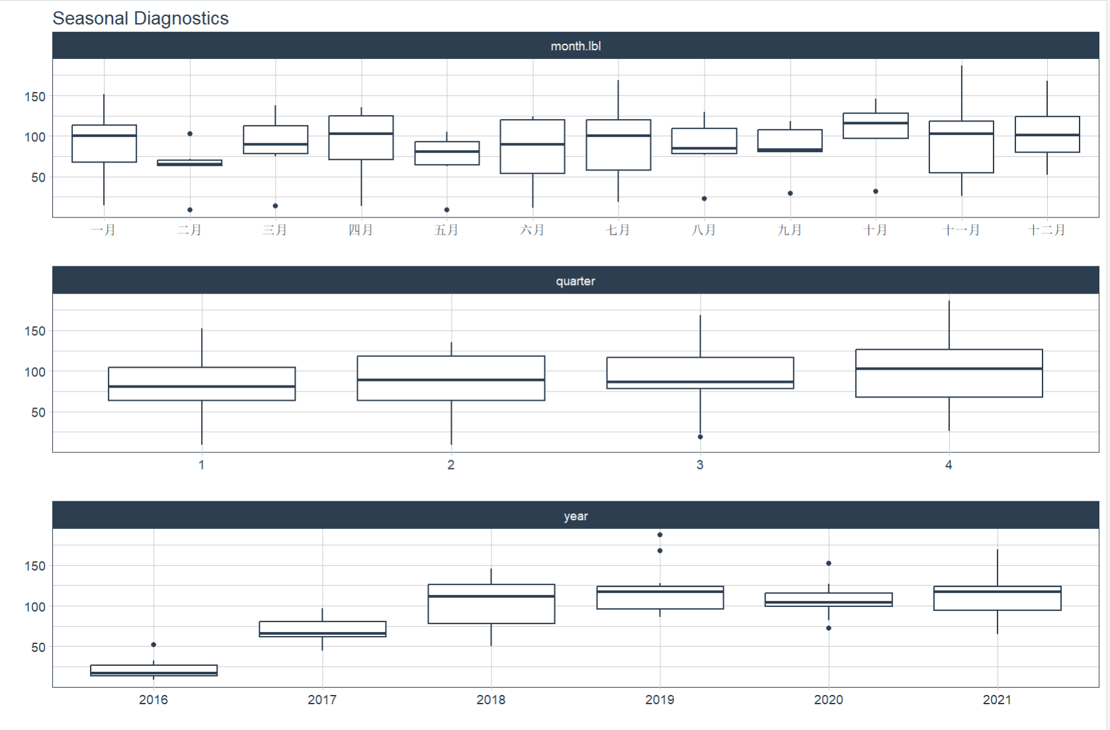
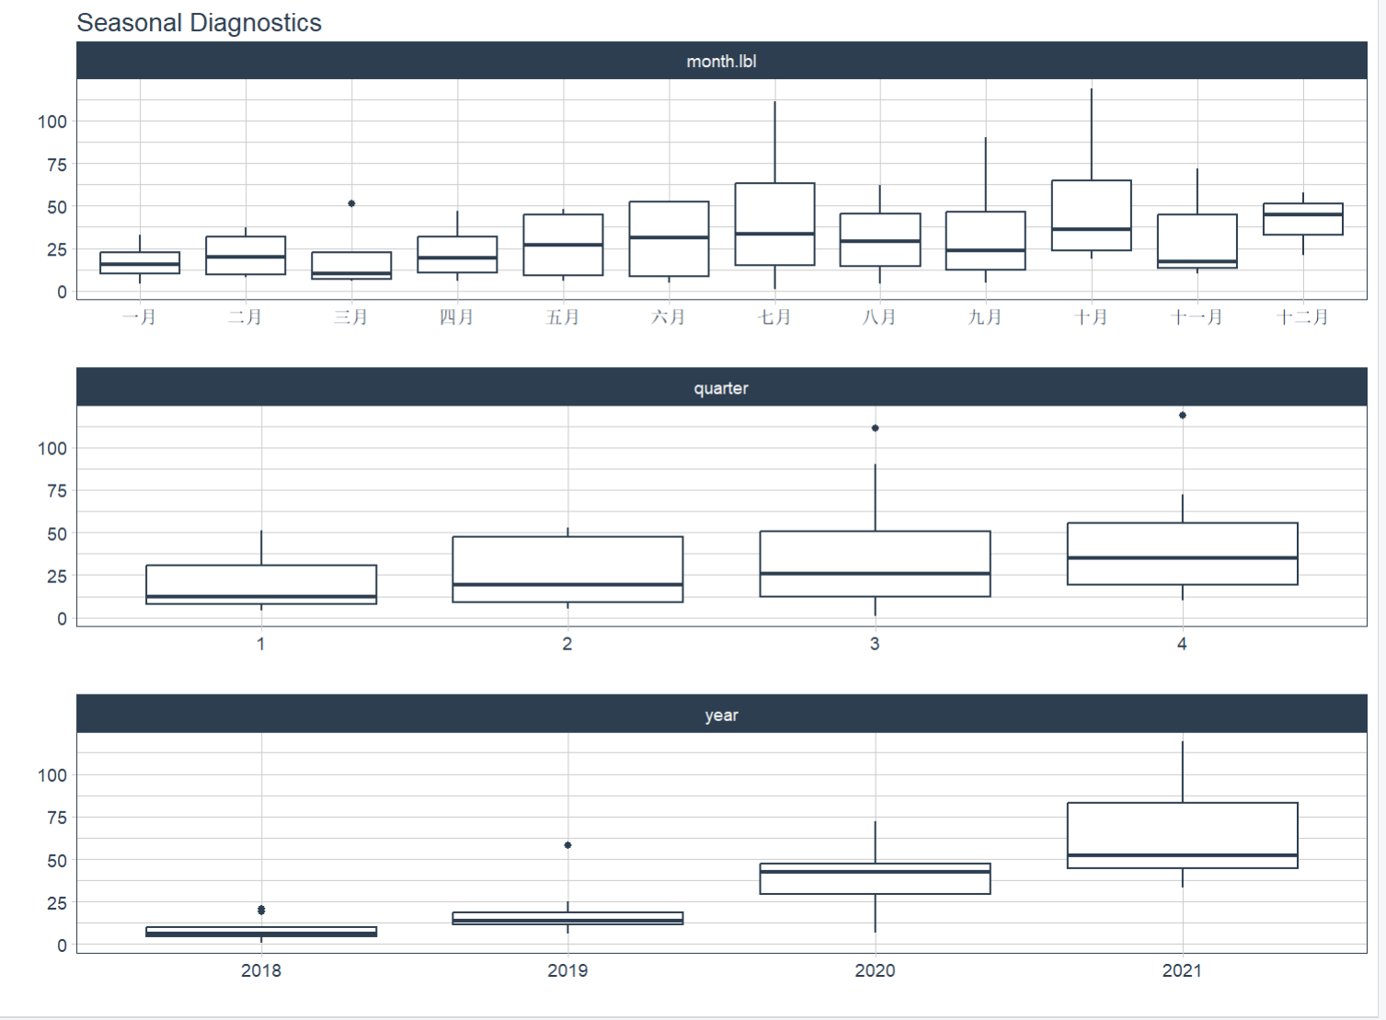
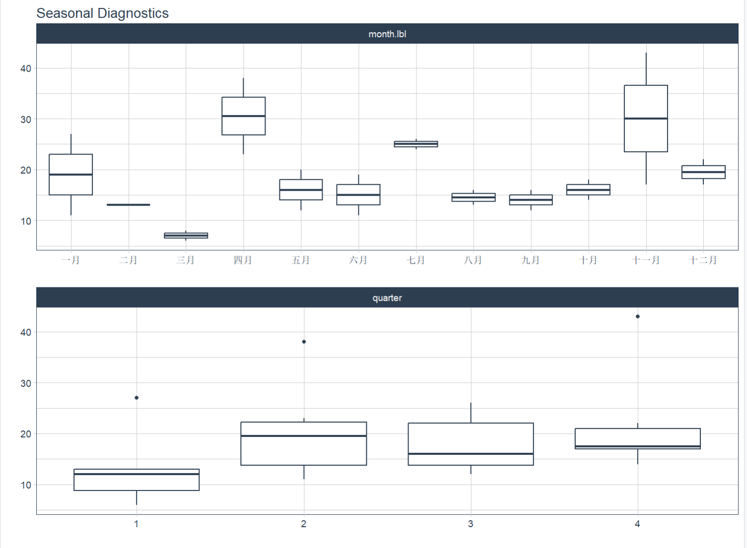
Seasonality Testing
Netflix
Hulu
Disney

Slide 19



Forecasting The Number Of New Movies
Will Be Released On Different Streaming Platforms
Netflix
Hulu
Disney

Slide 20
Model We Used
1, Auto-ARIMA Model
2, Prophet Model
3, Elastic Net (GLMNET)
4, Hybrid ML Model
(combine Prophet and XGBoost )

Slide 21
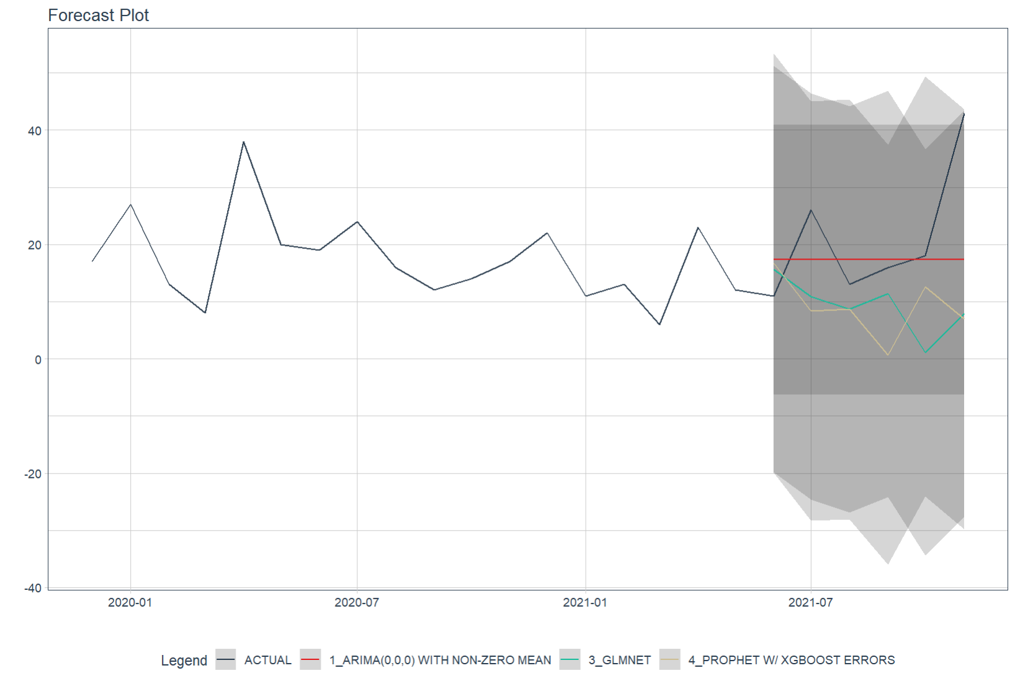
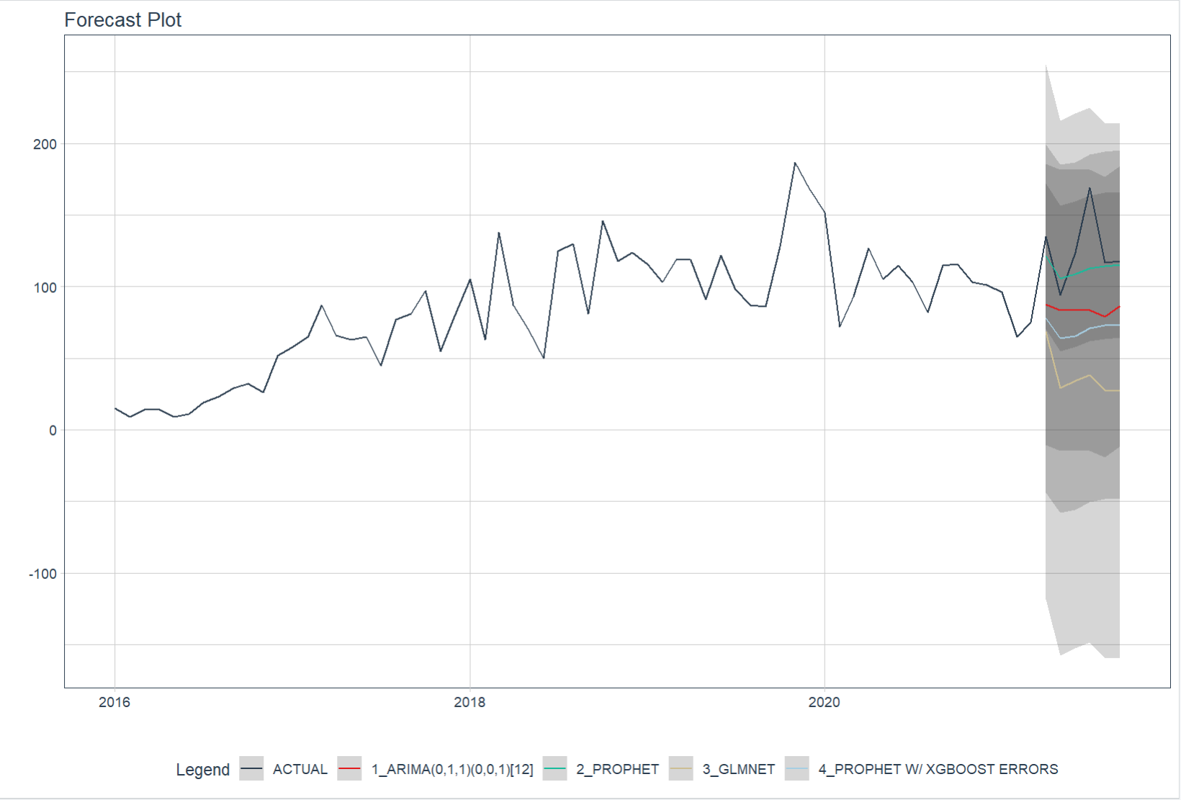
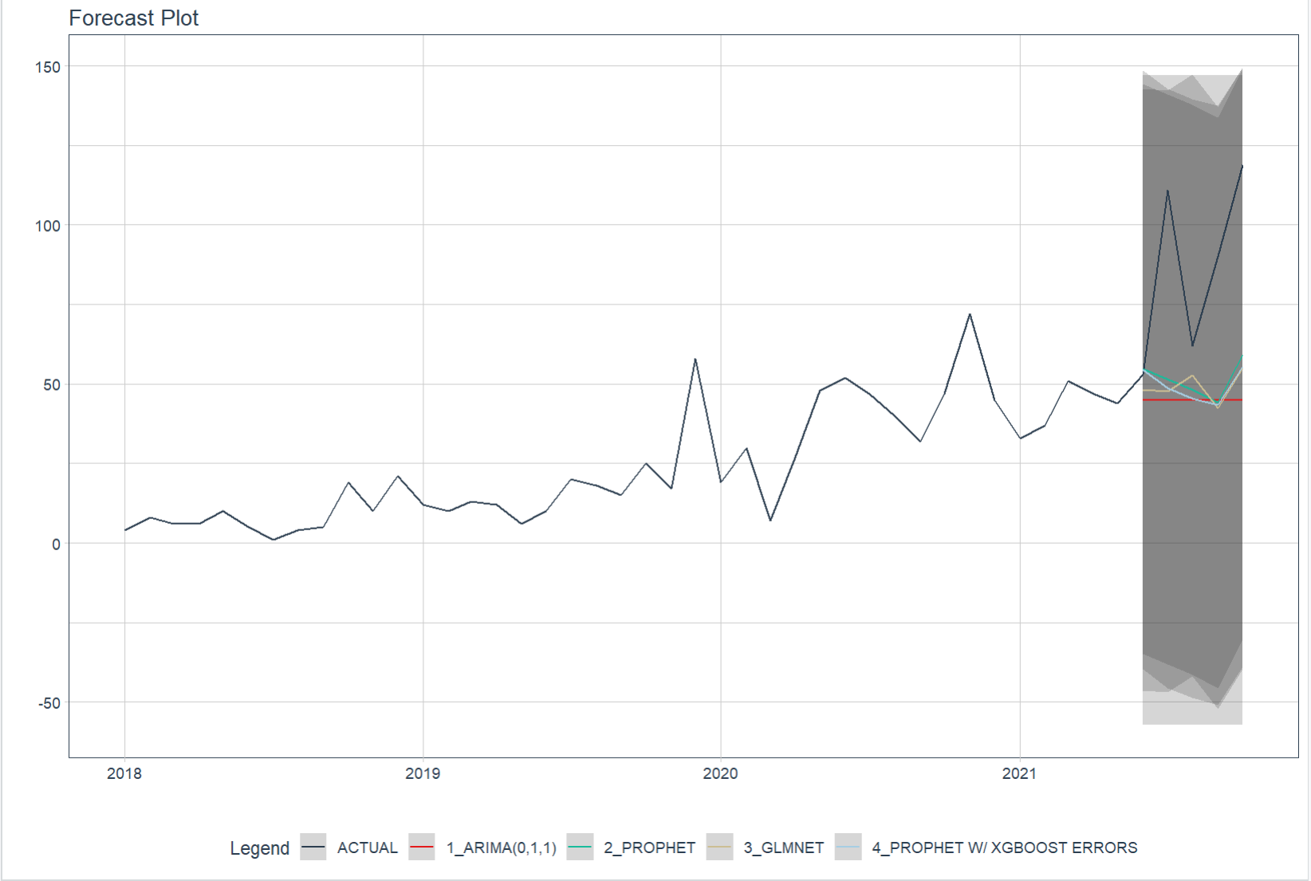
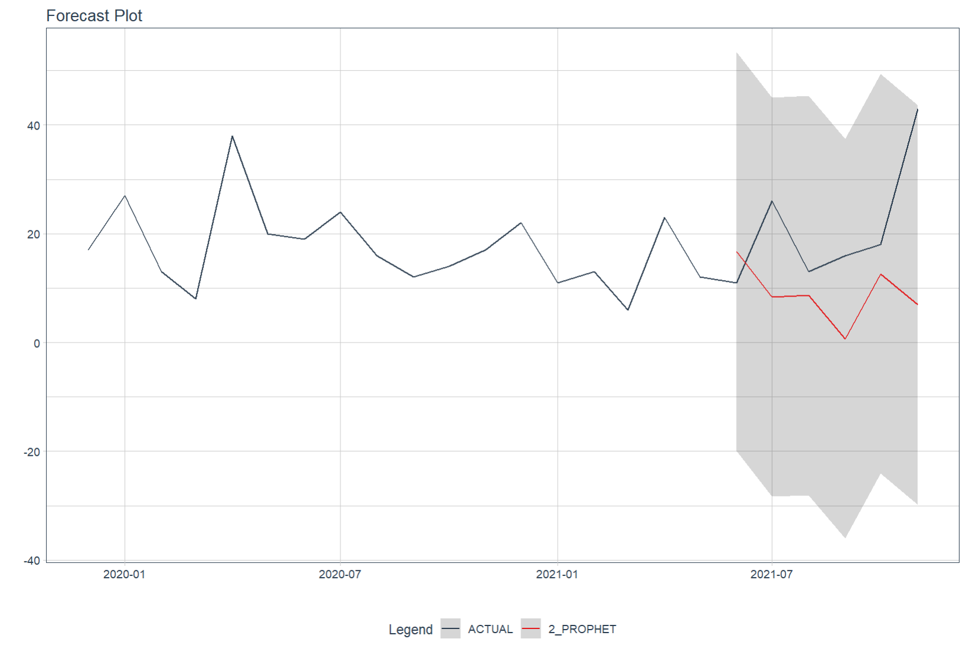
Validation
Netflix
Hulu
Disney

Slide 22
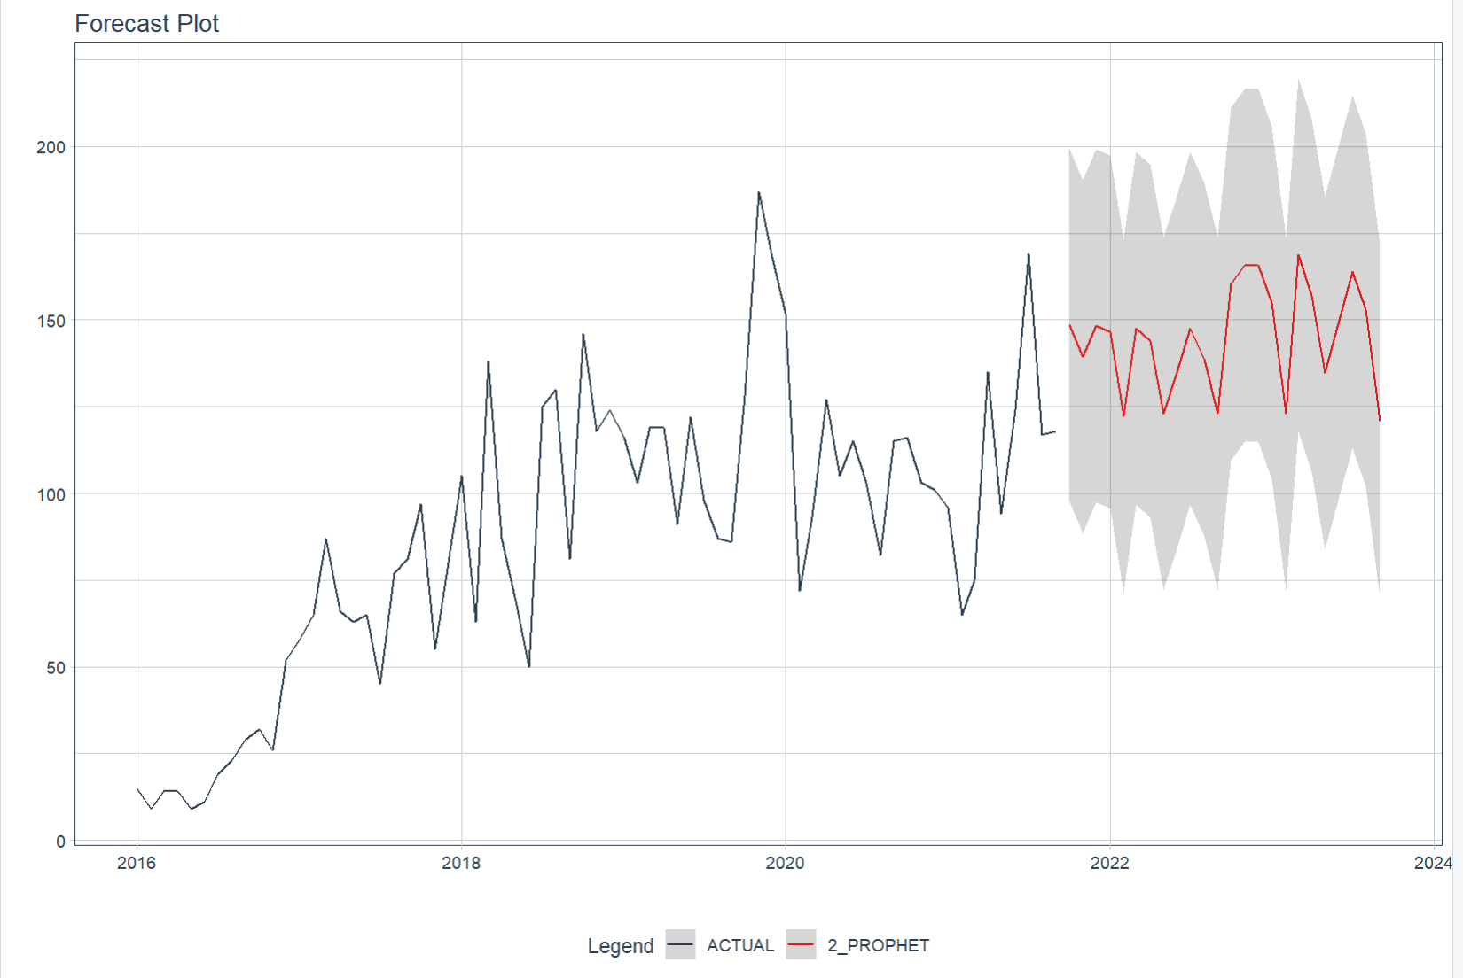
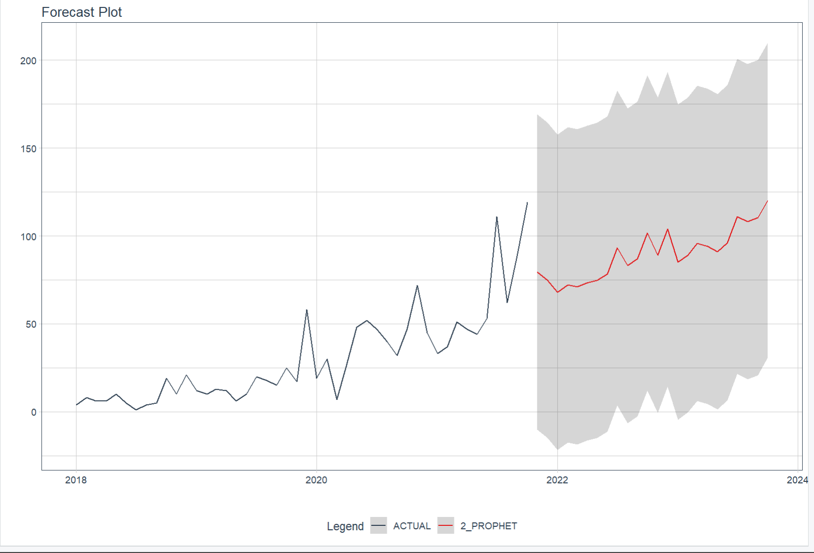
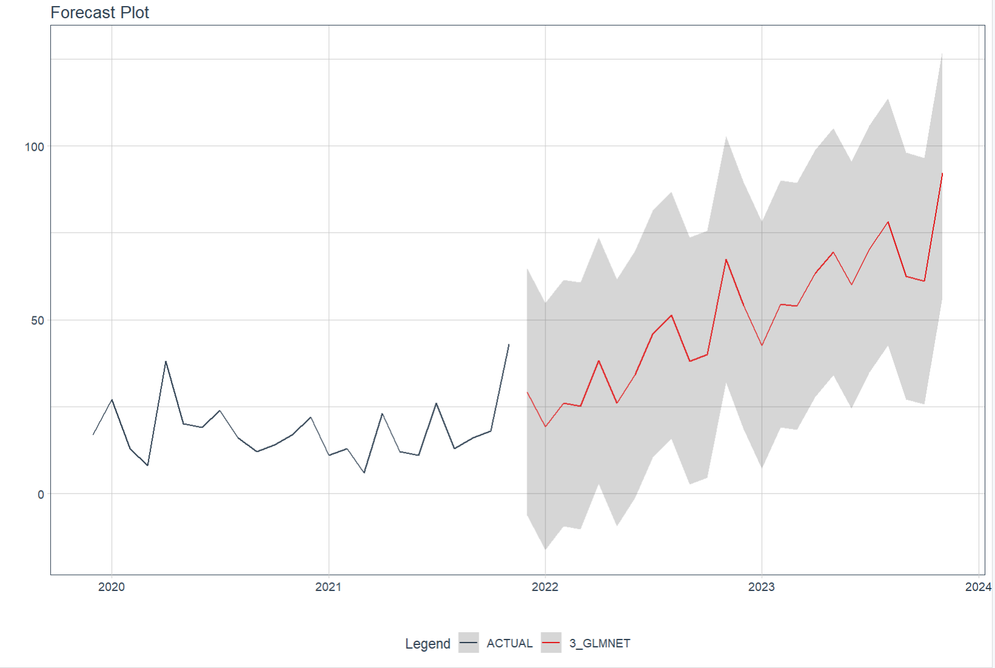
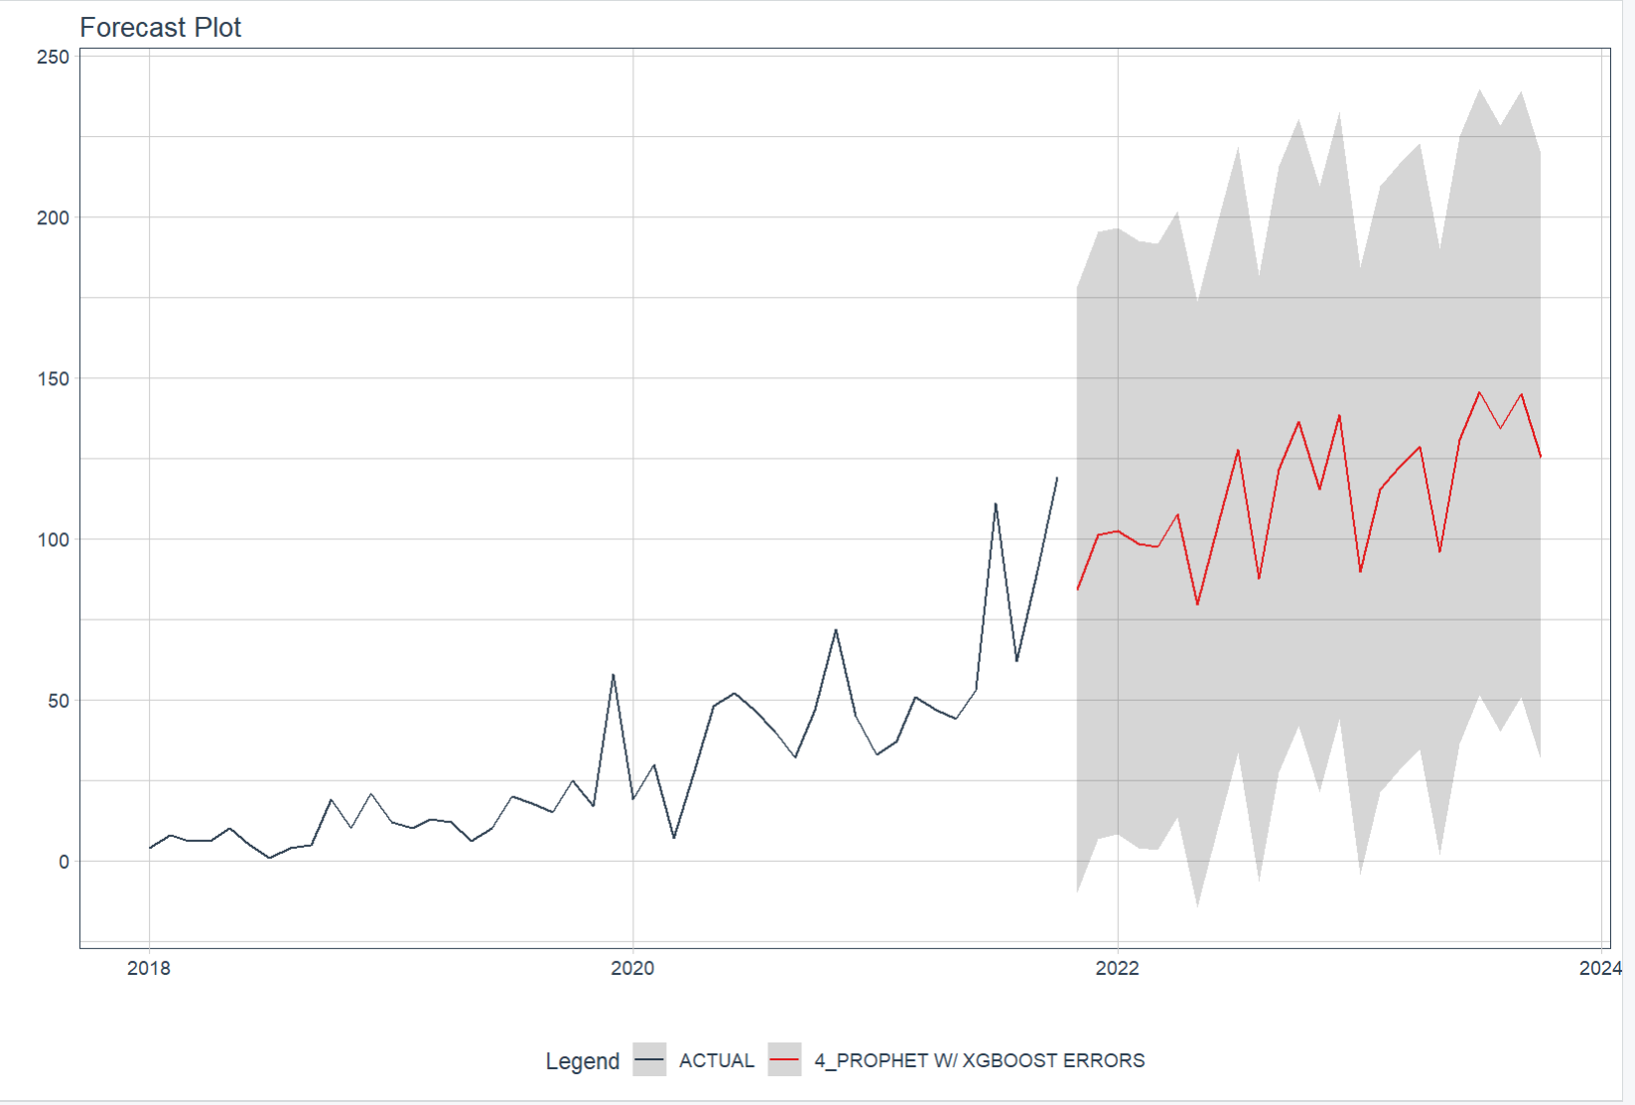
Forecasting For Each Platforms
Netflix
Hulu
Disney

Slide 23

Platform recommendation
Netflix

Slide 24
Limitations
1, Not add other variables to the model
2, Some uncontrollable societal factors may have an influence to the forecasting result
3, Hard to verify the completeness of the dataset

Slide 25
03
Model Development
How could we choose movies on streaming platform ?

Slide 26
Which Movie is worth watching ?
The IMDb score can be used as a movie viewing guide.
But what about newly released movies that don’t have rating?
We need to know what features of the movies affect the IMDb score.

Slide 27
Data Preprocessing
Standardization
Model requirements
Data cleaning
Dummy variables
Remove & Fill the N/A
For qualitative variables

Slide 28
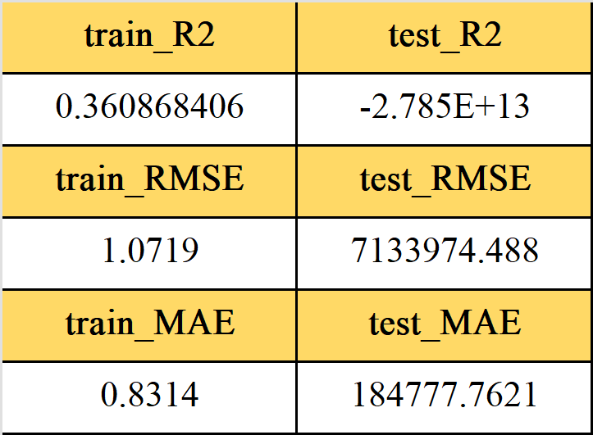
The problems with
OLS model
Over-fitting

Slide 29
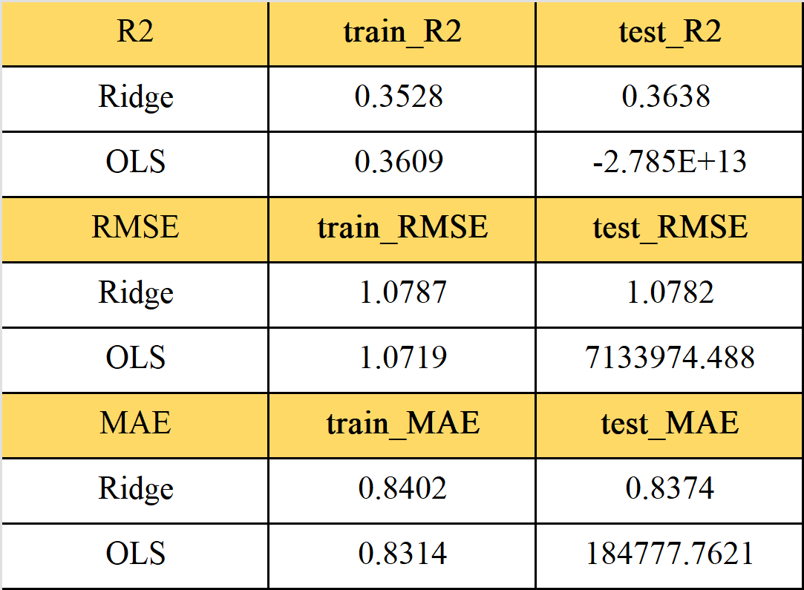
Ridge regression model
Ridge
vs.
OLS

Slide 30
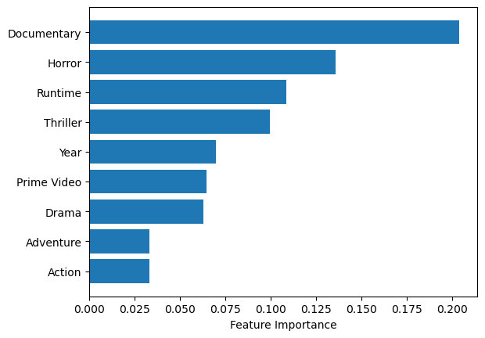
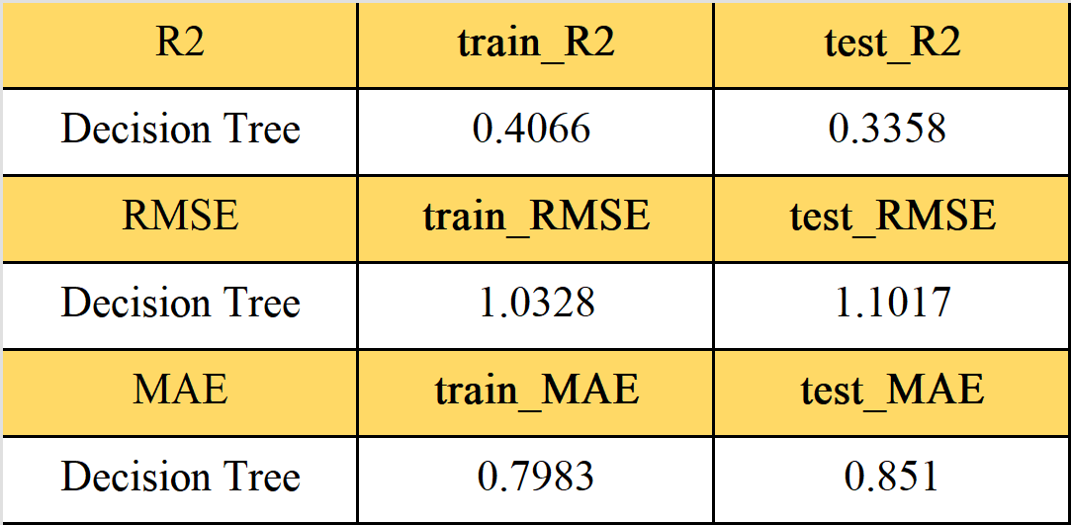
Decision tree
What features contribute the most to movie ratings ?

Slide 31
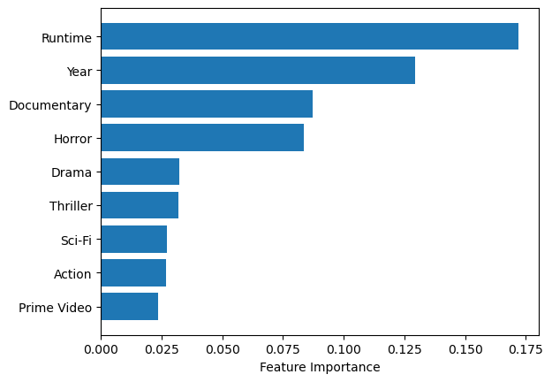
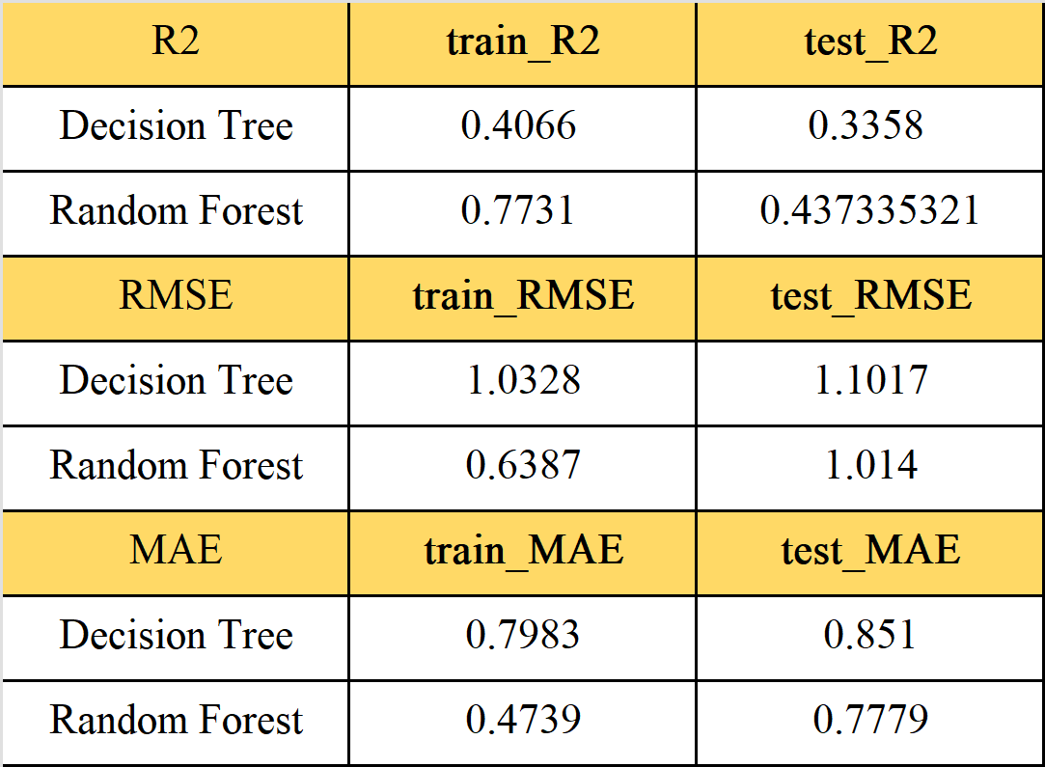
Random forest

Slide 32
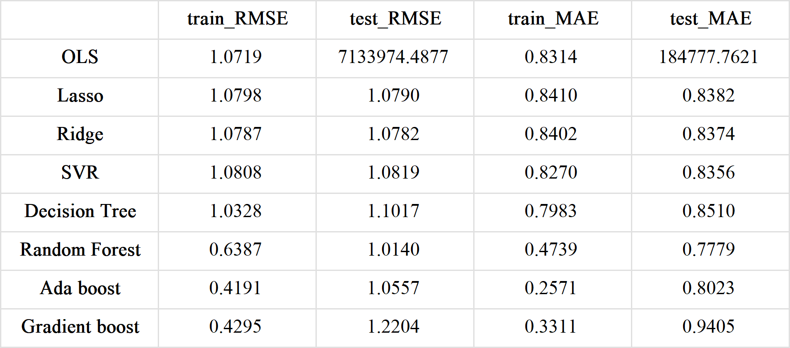
Model results

Slide 33
Limitations and application
Our weakness lies in need for other essential information about the movies.
The model can be used as a helpful guide for audience to decide on whether to buy a movie online without previous reviews.

Slide 34
Summary
Exploratory data analysis for each platform
Time series and machine learning approaches to forecast the number of new movies in 2023
Model the relationship between movie features and IMDb ratings with regression and tree-based models

Slide 35
Thank You!

